Slide 1
HEALTH SYMPTOM CHECKER agent
IBM AICTE PROJECT
Presented By:
Student name : MOHAMMED HAMIZ VR
College Name & Department : PRESIDENCY UNIVERSITY CSE CYBERSECURITY

Slide 2
OUTLINE
Problem Statement
Technology used
Wow factor
End users
Result
Conclusion
Git-hub Link
Future scope
IBM Certifications

Slide 3
Problem Statement
Many people lack access to quick, reliable guidance when they experience common health symptoms. They often search online and encounter misinformation, self-diagnose incorrectly, or delay seeking care. With the growing need for digital health support and multilingual accessibility, there is a gap in providing safe, educational, and non-diagnostic health assistance that users can easily interact with in natural language.
Proposed Solution: An AI Health Assistant Agent powered by Natural Language Processing (NLP), IBM Granite foundation models, and Retrieval-Augmented Generation (RAG), designed to help users describe symptoms in their own words. The agent interprets inputs, suggests possible causes, provides urgency levels, recommends home remedies, and advises when to consult a doctor. It supports multi-language interaction, avoids self-diagnosis, and promotes early detection by offering safe, referral-based, and trusted information — improving health awareness and action through a user-friendly conversational interface.

Slide 4
Technology used
IBM watsonx.ai Studio : To build and manage the AI agent
Granite 3-3-8B Instruct Model : For natural language understanding and response generation
Retrieval-Augmented Generation (RAG) : To enhance answers with external trusted data
Natural Language Processing (NLP) : To extract symptoms and user intent
Multi-language Support : For accepting input in different languages
IBM Cloud Lite : Hosting and deploying within IBM’s cloud infrastructure

Slide 5
IBM cloud services used
IBM Cloud Watsonx.ai Studio : For developing and testing the AI agent
IBM Cloud Watsonx.ai Runtime : To run and deploy the LLM-powered assistant
IBM Cloud Agent Lab : For building and configuring the agentic workflow
IBM Granite Foundation Model (granite-3-3-8b-instruct) : For language understanding and response generation
IBM Cloud Object Storage : To store static symptom-response data or documents
IBM Cloud Identity and Access Management (IAM) : For managing project and API access

Slide 6
Wow factors
Understands symptoms in natural language and gives safe, helpful advice
Uses real-time data from trusted sources (via RAG)
Suggests urgency level and home remedies (no diagnosis, just guidance)
Supports multiple languages for broader accessibility
Promotes early health action and reduces misinformation online

Slide 7
End users
General Public : Anyone looking for quick, safe health advice based on symptoms
Non-English Speakers : Users who need health guidance in their native language
Rural or Remote Communities : People with limited access to immediate medical care
Students & Young Adults : Curious users who often self-search symptoms online
Elderly Users : Those who need simple, understandable health assistance
Health Awareness Programs : NGOs or government bodies promoting early symptom checks

Slide 8
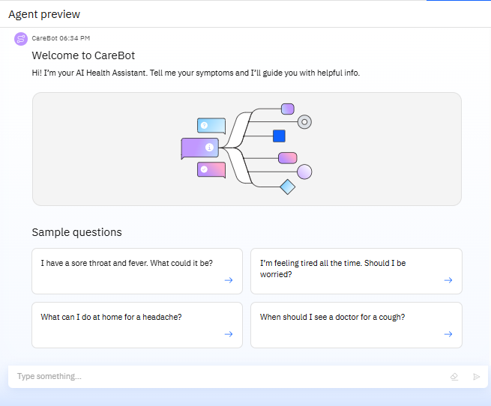
Results
This is the user interface of the CareBot health assistant. It welcomes users, shows example symptom questions, and lets them enter their symptoms in natural language for helpful guidance.

Slide 9
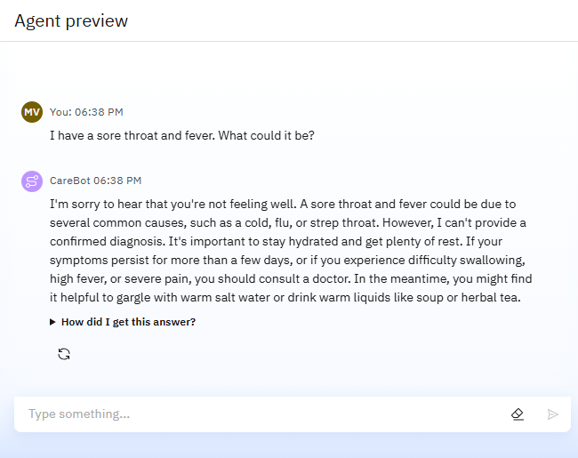
Results
This shows how CareBot responds to a user’s symptom query. The agent identifies possible causes, gives self-care tips, and advises when to see a doctor — all in a friendly, non-diagnostic, and easy-to-understand tone.

Slide 10
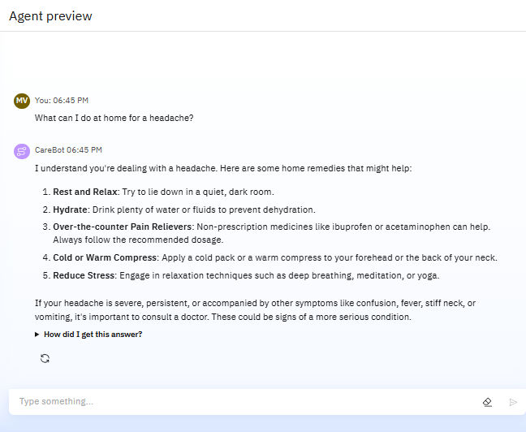
Results
The agent provides a list of safe home remedies for a headache, including rest, hydration, and stress relief. It also includes a safety disclaimer advising the user to see a doctor if symptoms are severe or unusual.

Slide 11
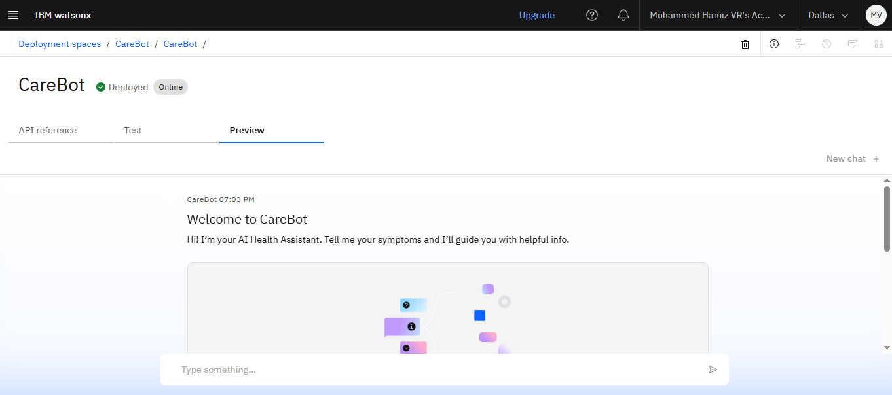
Results
Deployed AI Agent (Preview)

Slide 12
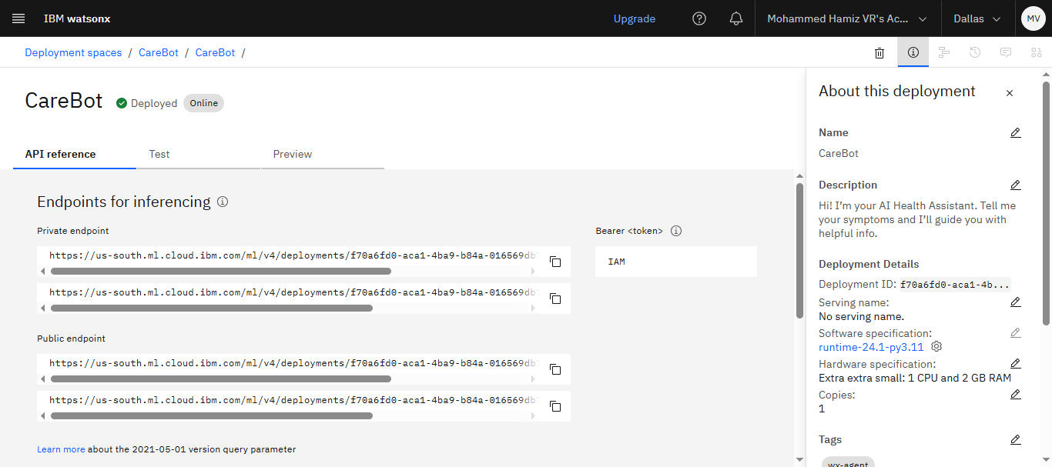
Results
Deployed AI Agent (API reference)

Slide 13
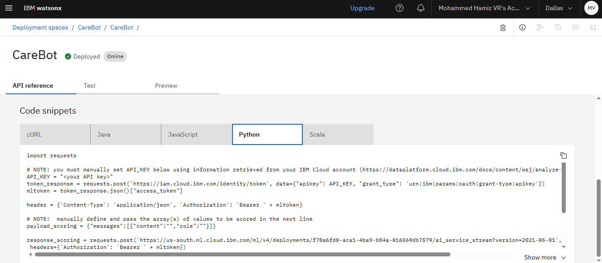
Results
Deployed AI Agent (Code Snippet)

Slide 14
Conclusion
The Agentic AI Health Symptom Checker empowers users to understand their symptoms using natural language, receive safe self-care guidance, and take timely action. Built with IBM watsonx.ai and Granite models, it promotes health awareness, reduces misinformation, and supports multilingual accessibility — all without replacing professional medical advice. This project demonstrates how AI can make healthcare support more accessible, educational, and user-friendly.

Slide 15
Future scope
Integration with Wearable Devices for real-time health tracking
Support for More Regional Languages to increase accessibility
Emotion Detection to understand user tone and stress levels
Mobile App Deployment for easier access on smartphones
Doctor/Clinic Recommendation System based on location and symptoms
Symptom Trend Analysis to detect outbreaks or common health patterns

Slide 16
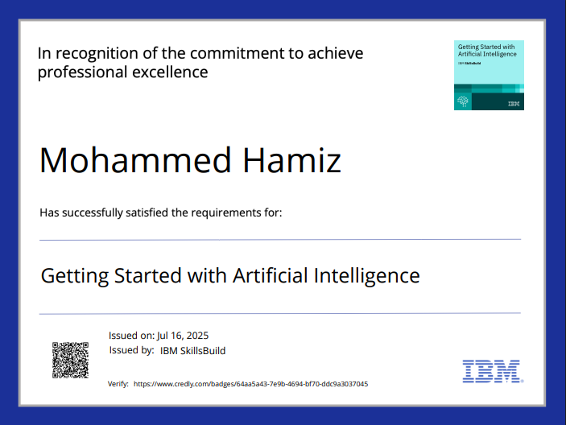
IBM Certifications
Screenshot/ credly certificate( getting started with AI)

Slide 17
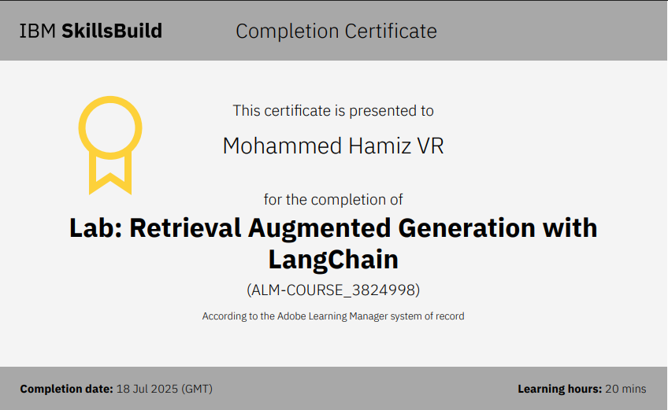
Attach your RAG LAB certificate here

Slide 18
GitHub Link

Slide 19
THANK YOU

